Slide 1
INTELLIGENT PARKING SYSTEM

Slide 2
INTRODUCTION
Most of the existing parking system are manually managed and a little inefficient.
The main problem is to manage parking in congested areas.
A good solution to overcome parking crises would be better management of existing parking spaces.
Hence online booking parking system is a proposed method that users can reserve their parking places using web.

Slide 3
OBJECTIVES
Finding a parking lot in an unknown locality.
Providing parking lot as per comfort.
Providing navigation to the parking spot.
Showing the shortest and optimal path from user’s current location to the parking lot.
Including a wallet for online hassle-free payment.

Slide 4
APPROACHES
Wired Sensor-Based
Wireless Based
Image based
Android App based

Slide 5
PERKS OF USING AN ANDROID APPLICATION
Learn parking
Time Saving
Graphical view
Online payment
Less human resource
Online bill generation
Cost-effective

Slide 6
MODULES IMPLEMENTED
Admin sub-system Modules:
Login
Updating Status of Parking Lot
Scanning the QR code

Slide 7
User sub-system Modules
User Registration / Login
User profile
Parking availability check
Book the parking spot
Navigation
QR Code Generation
QR Code Scan

Slide 8
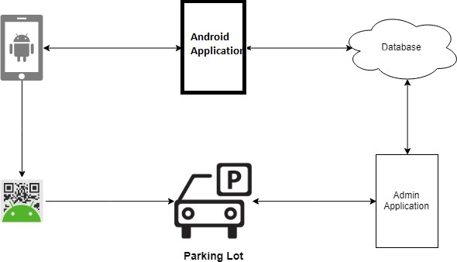
BLOCK DIAGRAM
Fig. Block Diagram of Proposed System

Slide 9
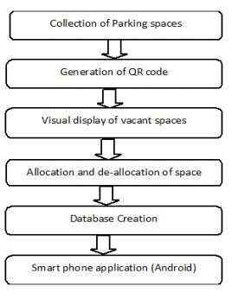
METHODOLOGY TO BE USED

Slide 10
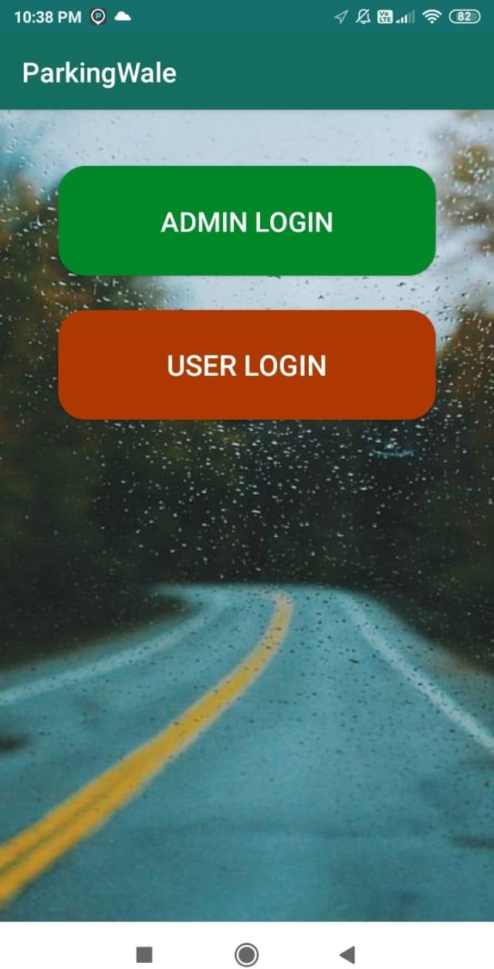
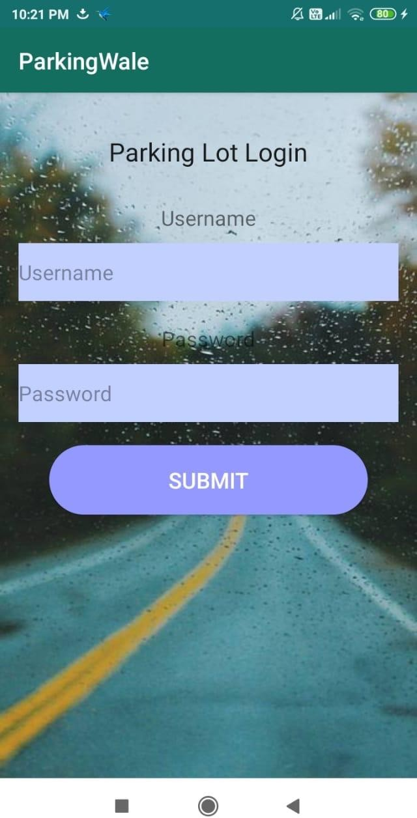
SCREENSHOTS
Fig. Main Screen Fig. Admin Login

Slide 11
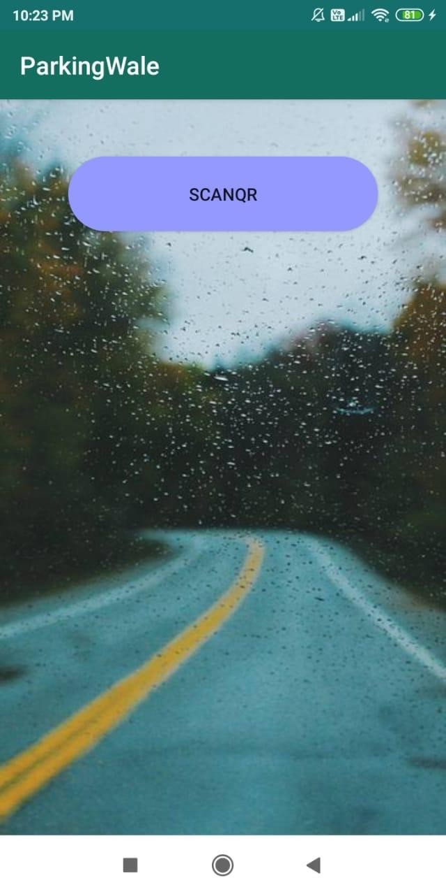
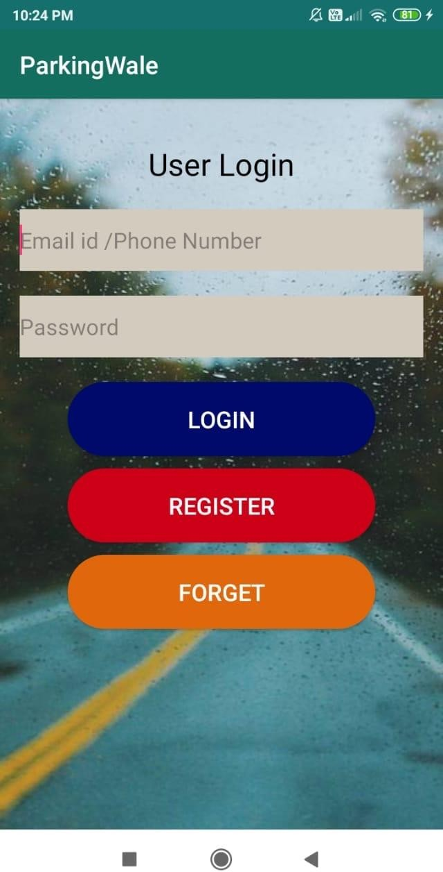
Fig. QR Scanner Fig. User Login

Slide 12
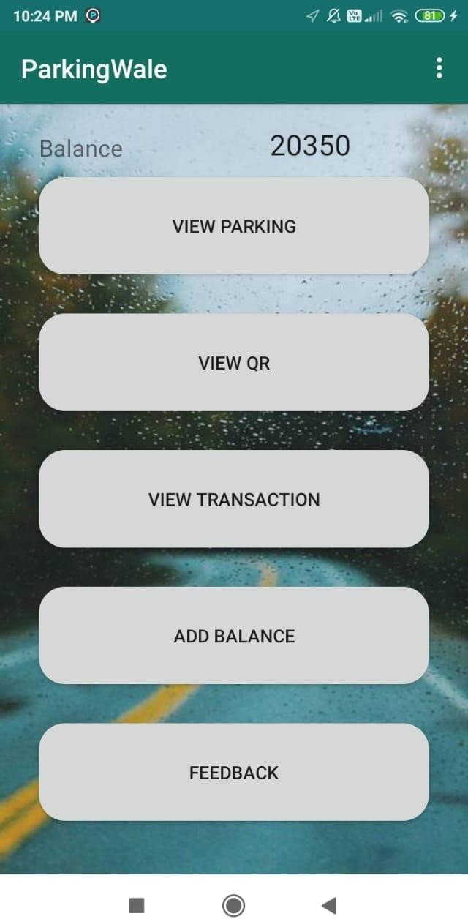
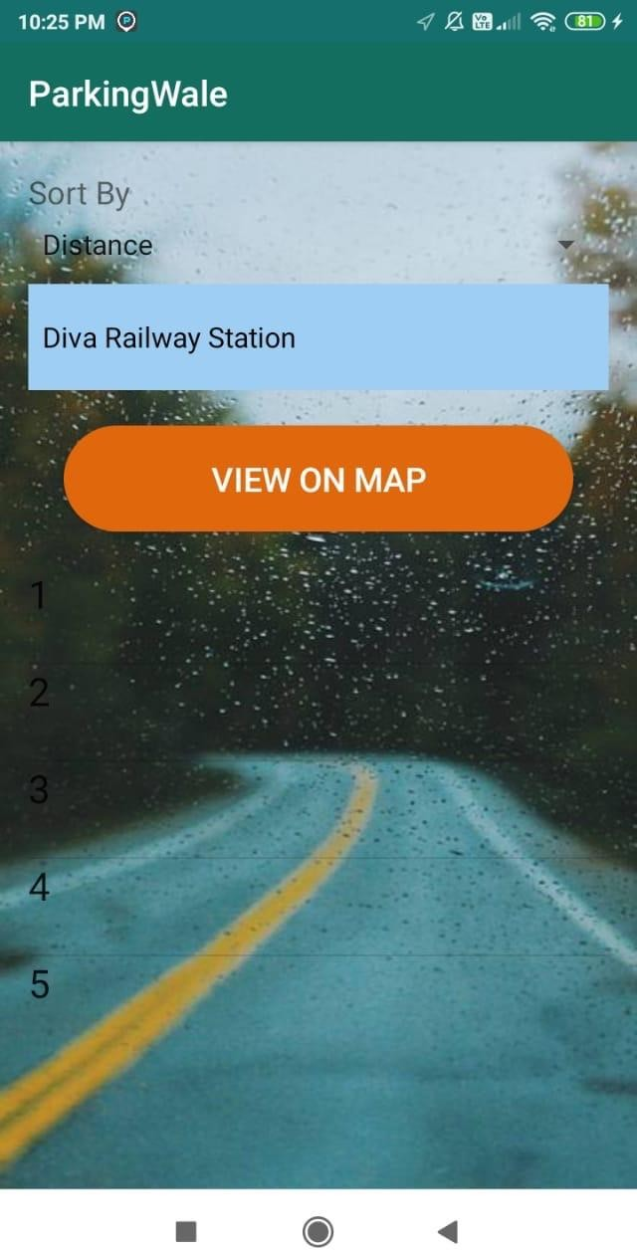
Fig. Main screen after Fig. Booking Slot
user logins

Slide 13
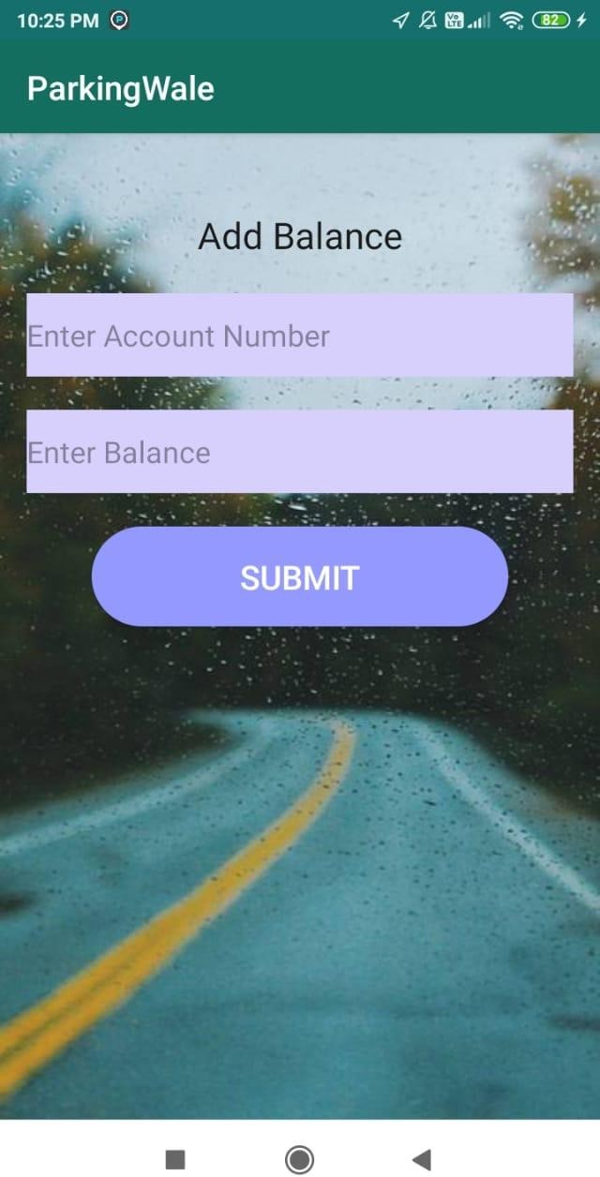
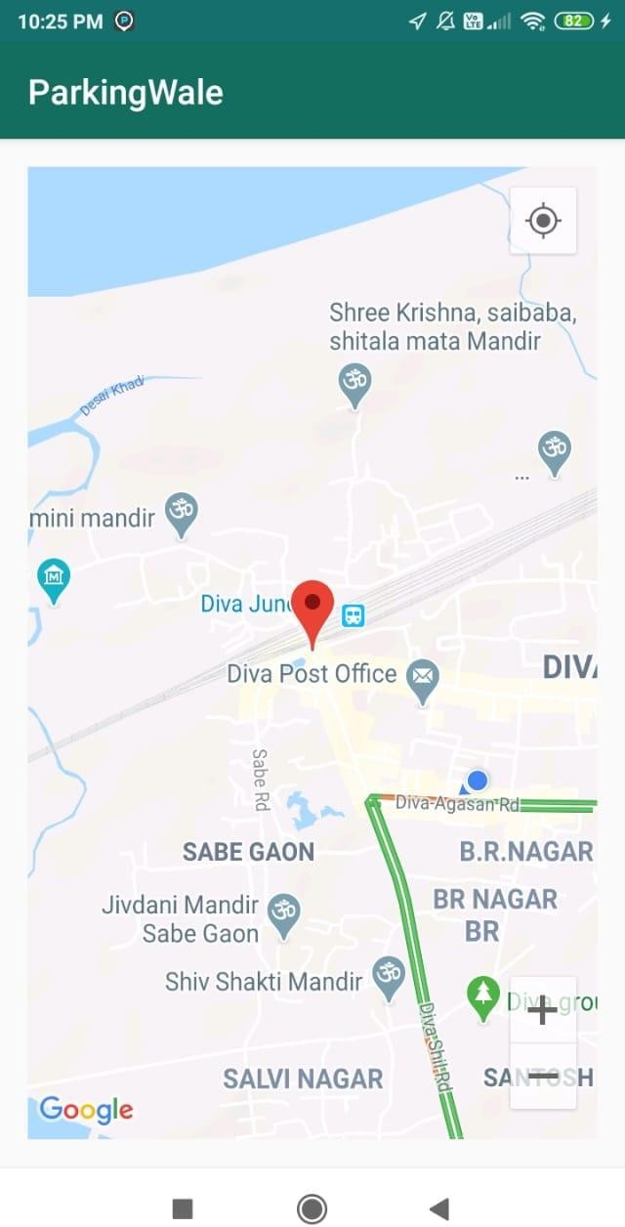
Fig. Adding Balance Fig. Map view of slot

Slide 14
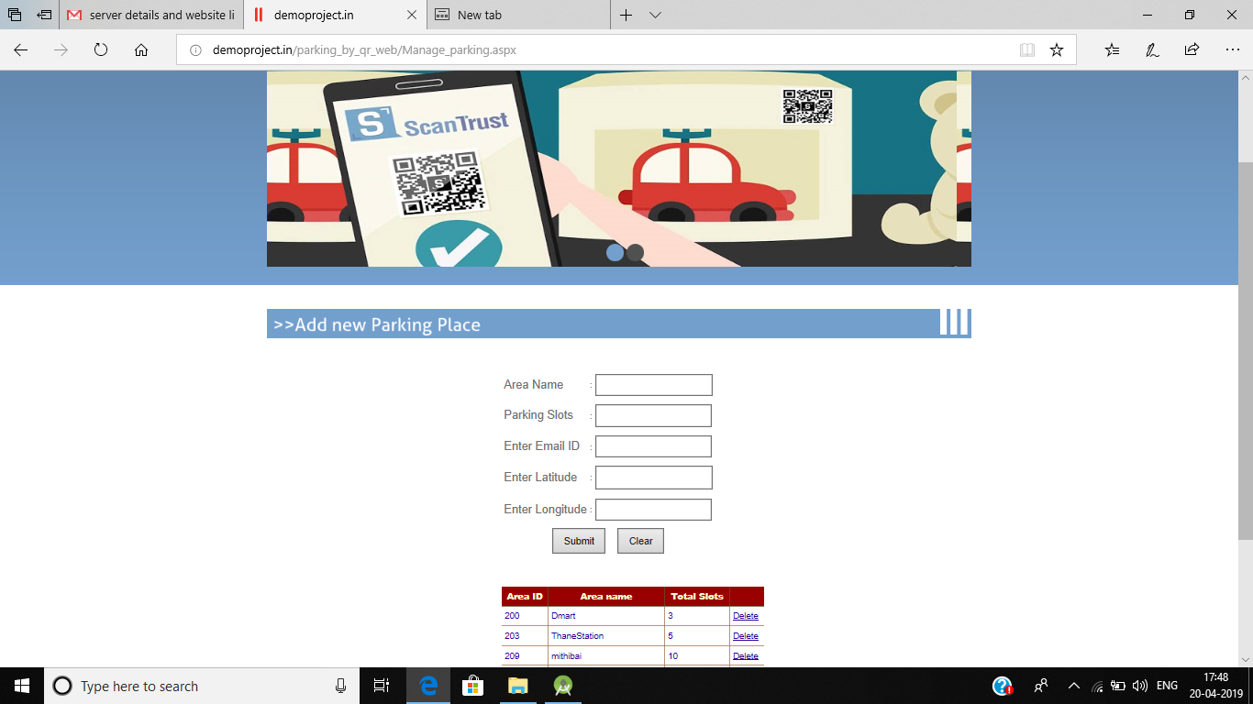
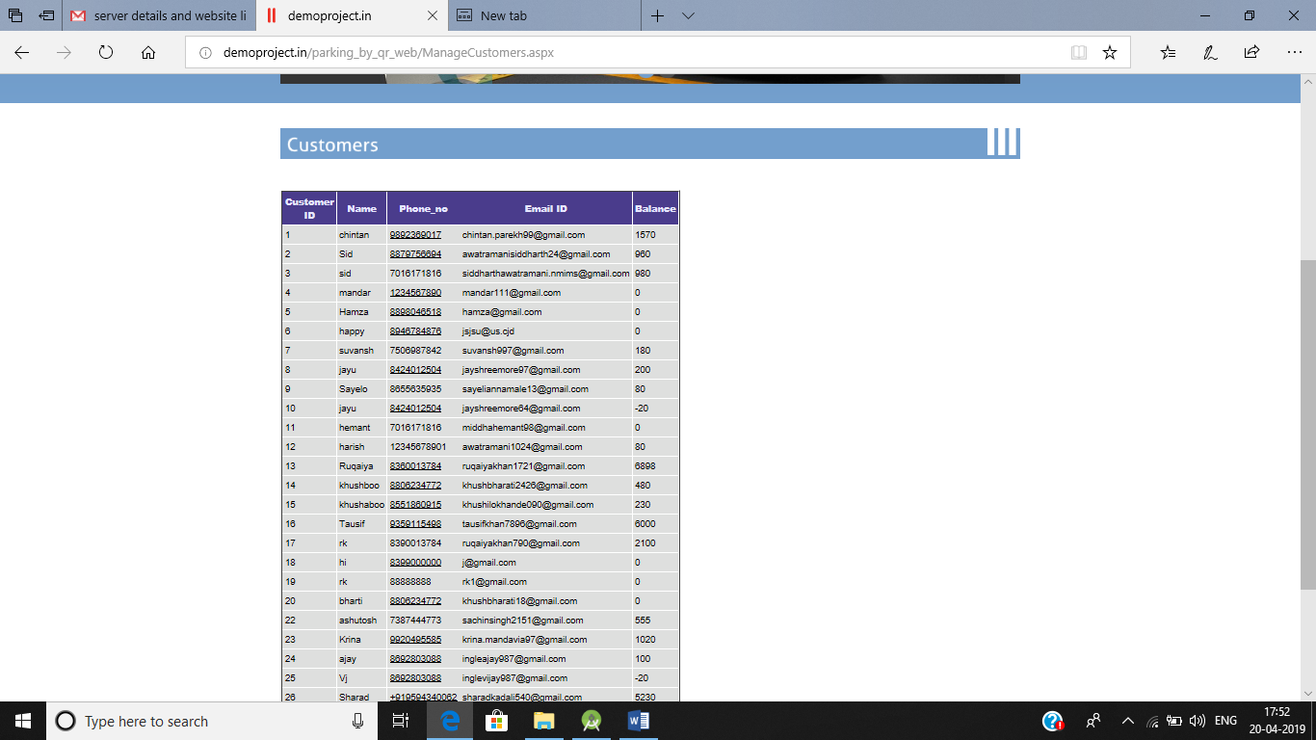
Fig. Admin Web page

Slide 15
CONCLUSION
We implement parking reservation policy to balance the benefit of service providers.
The system implements a dynamic allocation of parking slots to the users.
This system helps user to find and reserve a space and also to save time, fuel and energy.
User authentication and payment authentication are formulated using QR code.

Slide 16
THANK YOU

